Slide 1
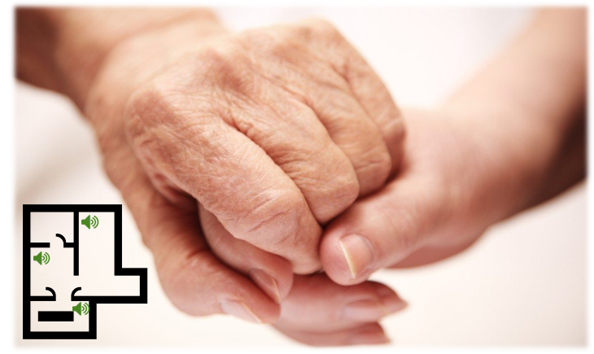
Smart Alert Sound System
AudiHome
Dasom Eom
Ji-Won Jung

Slide 2
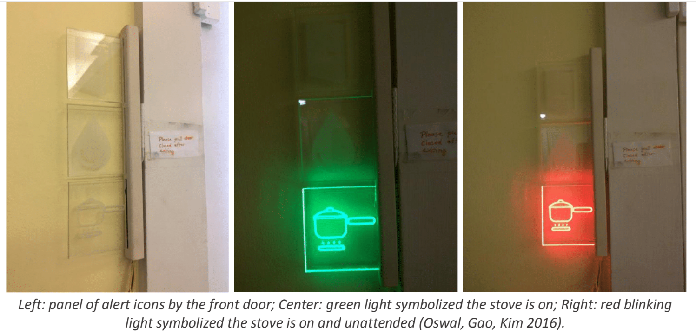
Intro - Ambient Alerting System (Brian Jones)

Slide 3
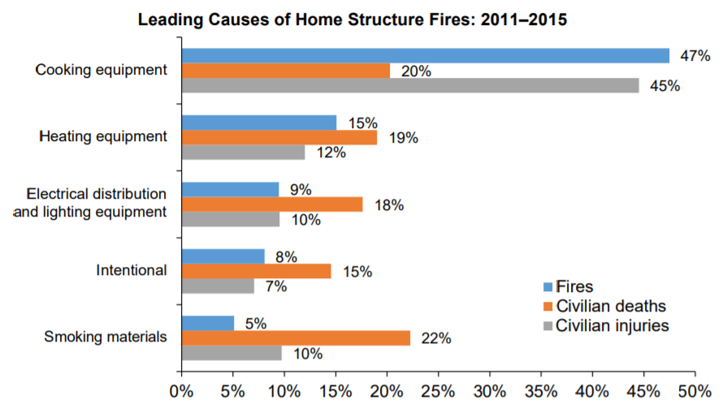
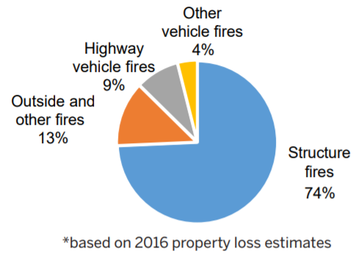
Research & Survey
(NFPA) 475,500 structural fires in 2016, 74% home fire, 81% civilian fire death caused by home fire, 47% home fire caused by unattended cooking (38%)
3 of every 5 home fire deaths resulted from no smoke alarms or none that worked, nuisance (false) alarms leading cause of disabling alarms
(Survey of 32 people) 71% left something on stove and triggered fire alarm, 56% had experience disabling fire alarm
Notes:
1,342,000 fire resports

Slide 4
Problem/Solution
Problem:
Unattended cooking fire is a very serious life-death problem in USA
Even with working fire alarms, 38% of fire deaths caused by unattended cooking
Nuisance (false) alarm - annoying to hear smokey cooking or shower steam, result: often turned off
Solution:
Alert system focused on raising awareness of stove top cooking
Noise that people can be habituated to - cater to individual style
Noise that can be attention grabbing
Other sound alerting system can follow the theme of stove top

Slide 5
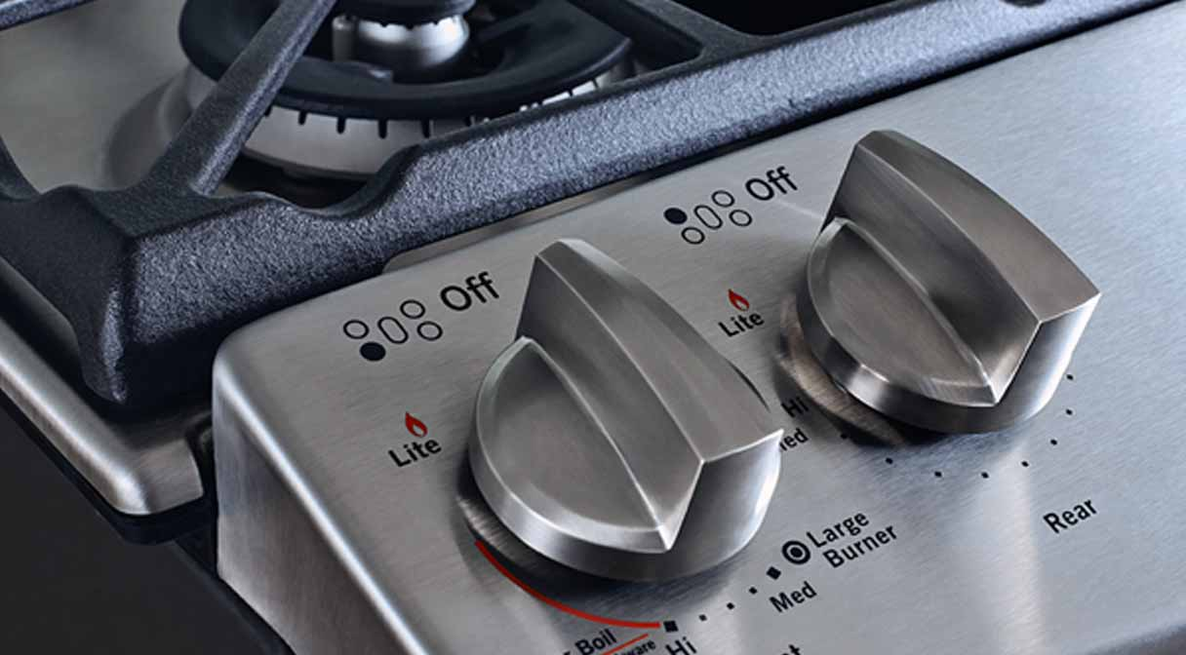
Initial Soundboard
Start sound - short
End sound - short
10min alerts - Ambient
1 hour strong alert - Annoying and strong
door alert

Slide 6
Test Scenario
Case 1 - Default Use Case
Case 2 - Long Use Case
Case 3 Default Use Case, user forgot to turn off
Case 4 - Long Use Case, user forgot to turn off
Case 5 - User does not turn off the stove when leaving the door
Case 6 - Guest comes in at door when cooking
Case 7 - Turn off Alert Use Case
<Motion Sensor>

Slide 7
Initial Feedback on soundboard
Customization is good but better have a default soundboard
Ambient alert (Louder sound effect to quiet sound effect)
Notify the current status
Alexa-like voice over
Connection over the entire home vs Local alert
Door open alert - street noise too loud
Door open alert - better have a tts

Slide 8
Next Steps
Finishing Prototype soundboard (length of sound, AI voice, level of alert)
Wizard of Oz testing on people
Survey types of music and get feedback of use cases
Reflect and modify sound design
Apply sound design on other appliances

Slide 9
Any Question or Advice?

